Slide 1
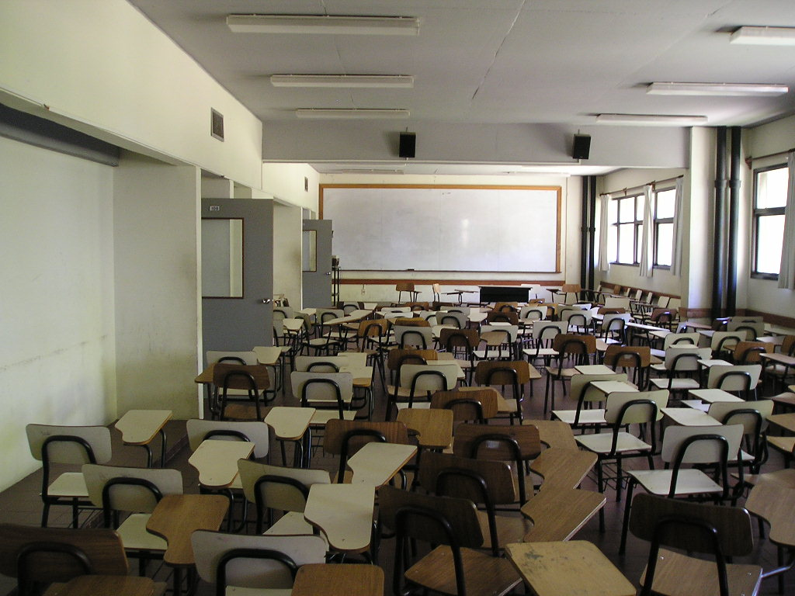
Technology in a JK Classroom

Slide 2

Why
use
technology
Notes:
The technology available today is truly powerful. From hardware to software to everything in between, the technology of the 21st century has the potential to help our world economy grow exponentially. In order for our youth to be a part of this growth, they have to have the skills necessary to compete in a global economy. And, there is no better way for students to gain this knowledge and skills than to make use of the age appropriate technology available. In this way, they will develop as 21st century learners. Why use technology…?

Slide 3
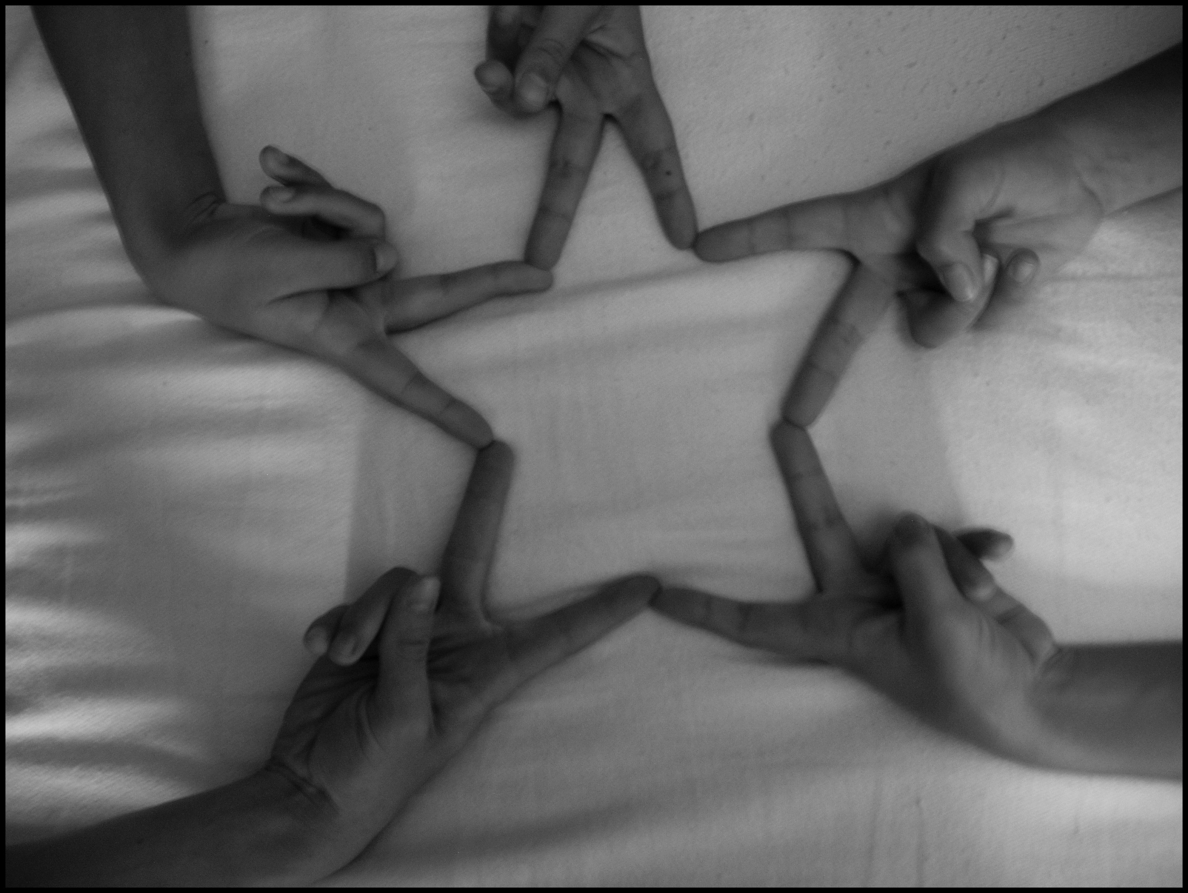
collaborative
Notes:
Students can work together to create, re-create, revise, and share with others around the world, connecting them to the global discussion.

Slide 4

fun
Notes:
Technology can be fun to learn and fun with which to create. It provides students with hands-on opportunities to be unique, no matter what their abilities.

Slide 5
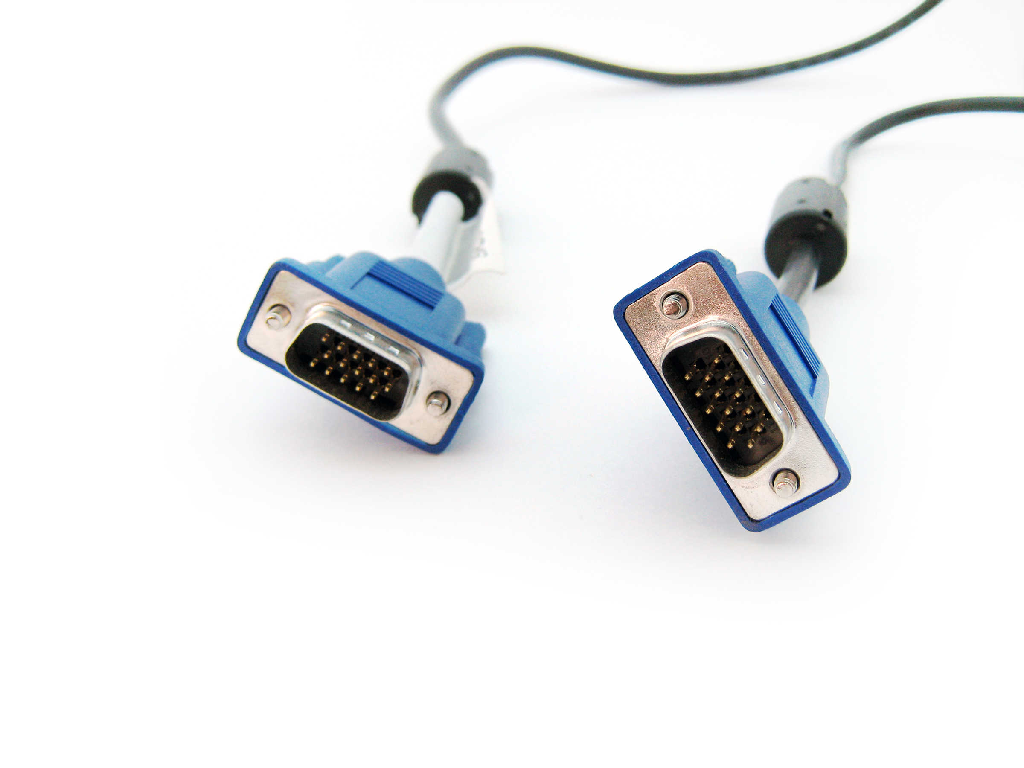
connects
to
the
21st century
Notes:
There will be very specific abilities required by 21st century workers. They will need to be self-motivated, creative problem-solvers, who have strong computer skills and knowledge of a variety of programs and their capabilities.

Slide 6

How
will we use
technology?
Notes:
Many of the tools your child will use are collaborative tools. They’re tools which connect them to the wider world, whether it is through sharing their work with others or by working directly with them on a shared task. These tools also allow your child to have a choice in the content of his/her learning. The Internet is a massive resource of information with access to many experts in almost any field imaginable. It allows individuals opportunities to gain knowledge and best practice in a myriad of ways.
My role in this endeavour is as facilitator of knowledge, rather than the traditional director. Therefore, the assessment pieces your child will complete are designed by me to meet curricular goals, but whose topics and ways of demonstrating learning are chosen by your child.

Slide 7


math
SOLVING
problems in
Notes:
Students will use both online and offline software to help them solve and prove the riddles of math.

Slide 8

forms
of
writing
Notes:
Students will use online tools to observe exemplary work, create exemplary work, and share their exemplary, through a variety of applications.

Slide 9

strategies
r
e
a
d
i
n
g
Notes:
Students will develop skills in reading by making use of online books which can be read aloud to them, so that they can access the content. They will also make meaning out of other online content such as comics, images, ads, and commercials.

Slide 10
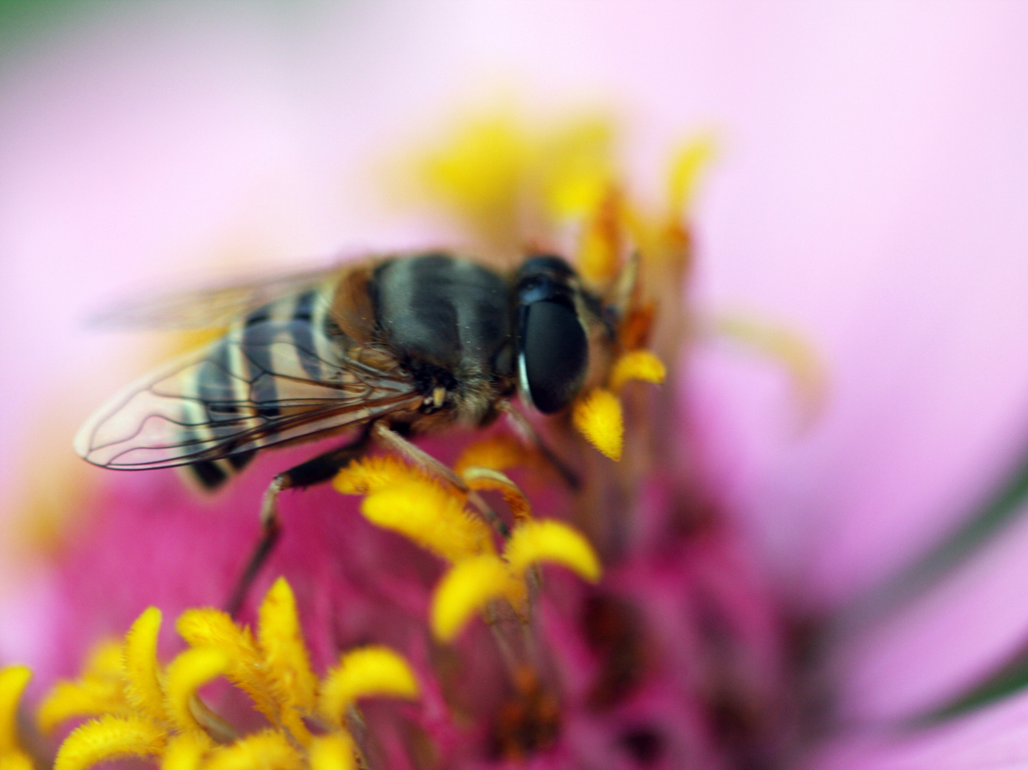
observe
the mysterious
Notes:
Students will experience the world around them, whether minute or grand, through the use of captured video footage, digital photos, as well as audio, and use this as a springboard for further inquiry.

Slide 11
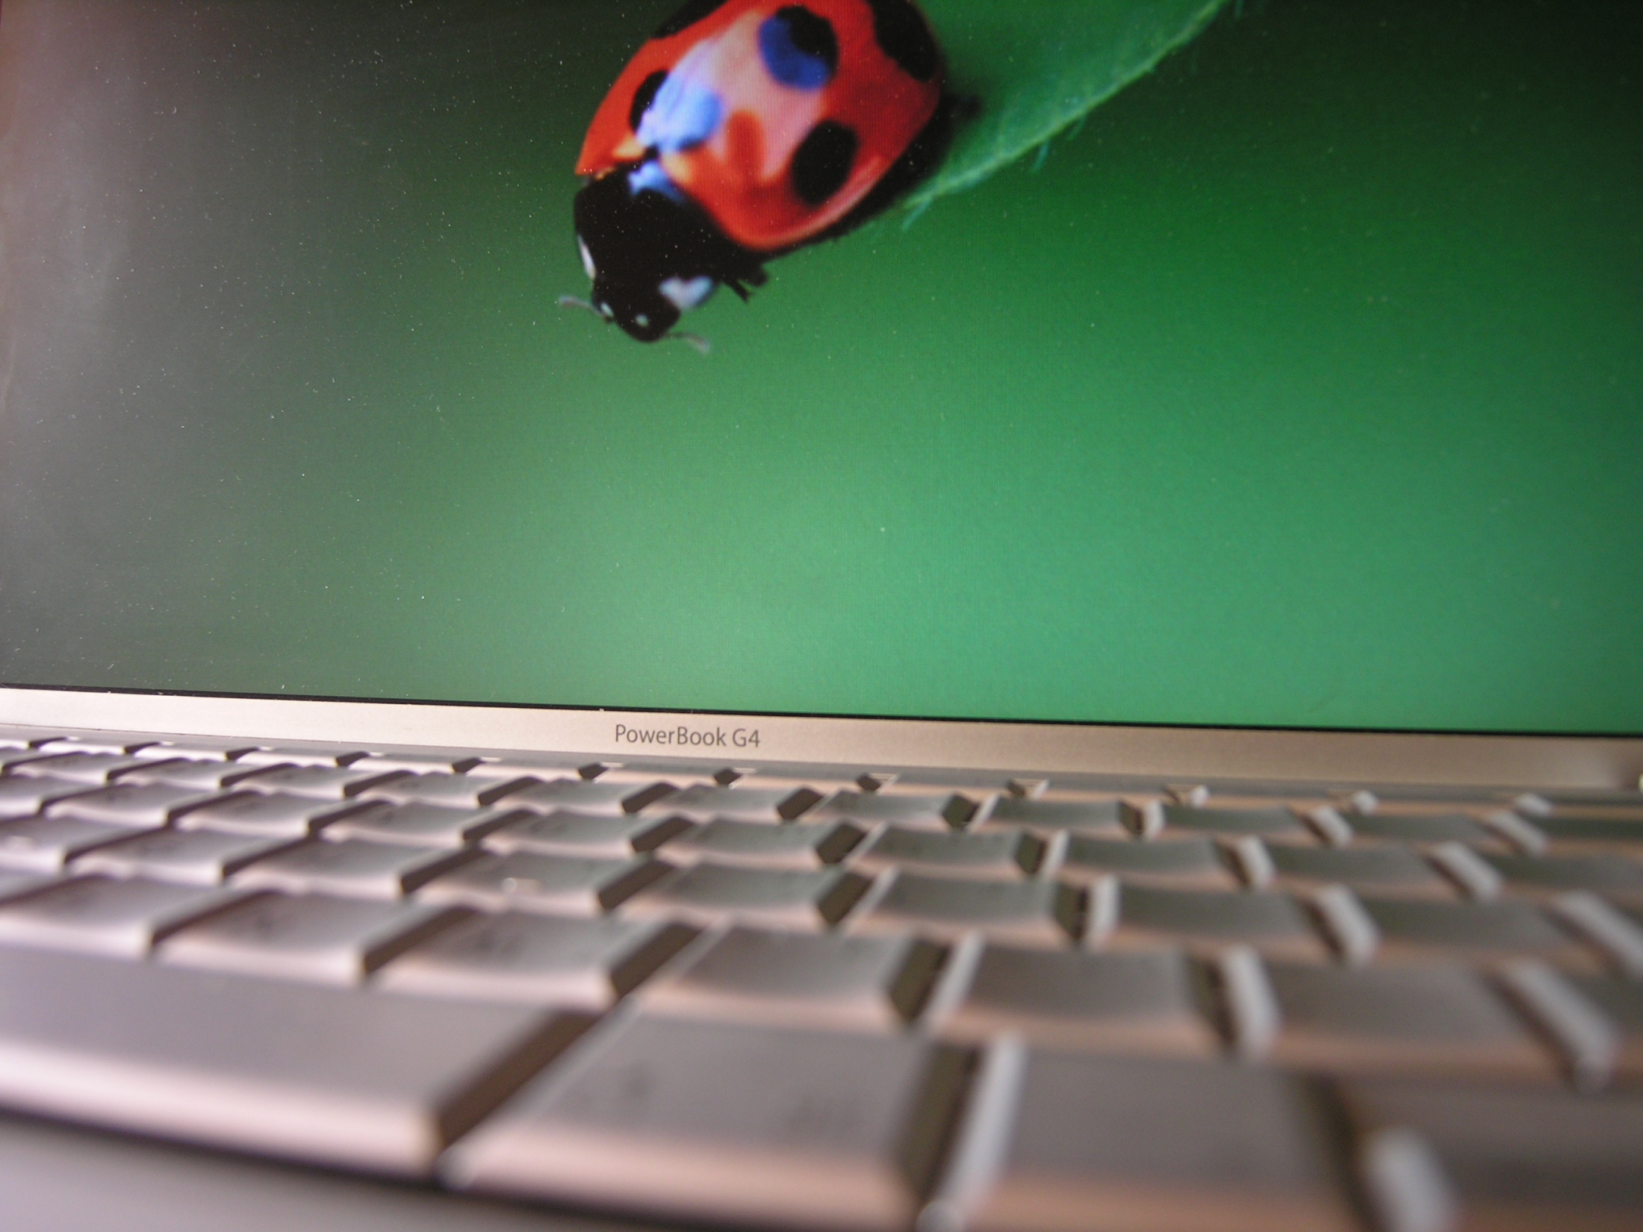
What
tools
What tools
will we use?
will we use?
Notes:
Students will make use of both online and offline tools. The online tools are web tools whose function is to make collaboration and sharing easier. Some of these tools have other functions as well. Your child will use presentation tools, unlike the one I’m using here, the slideshow; writing tools, like blogs; reading tools, such as online books; as well as math tools, like ixl.com. All of this tools are available to students both at school and at home, 24 hours a day, 7 days a week, and on almost any mobile device, making learning possibilities happen everywhere.
Offline tools like software programs will be loaded on to the school’s server of which your child will have access. Software programs like Millie’s Mathhouse, Starfall as well as Paint. Students will also access websites like ixl.com. Students will use hardware such as iPads for photos, video, and audio. They will also use many Apple apps. to create multimedia presentations and digital stories.

Slide 12

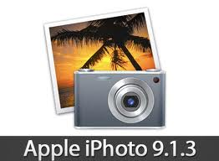


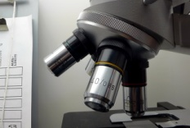
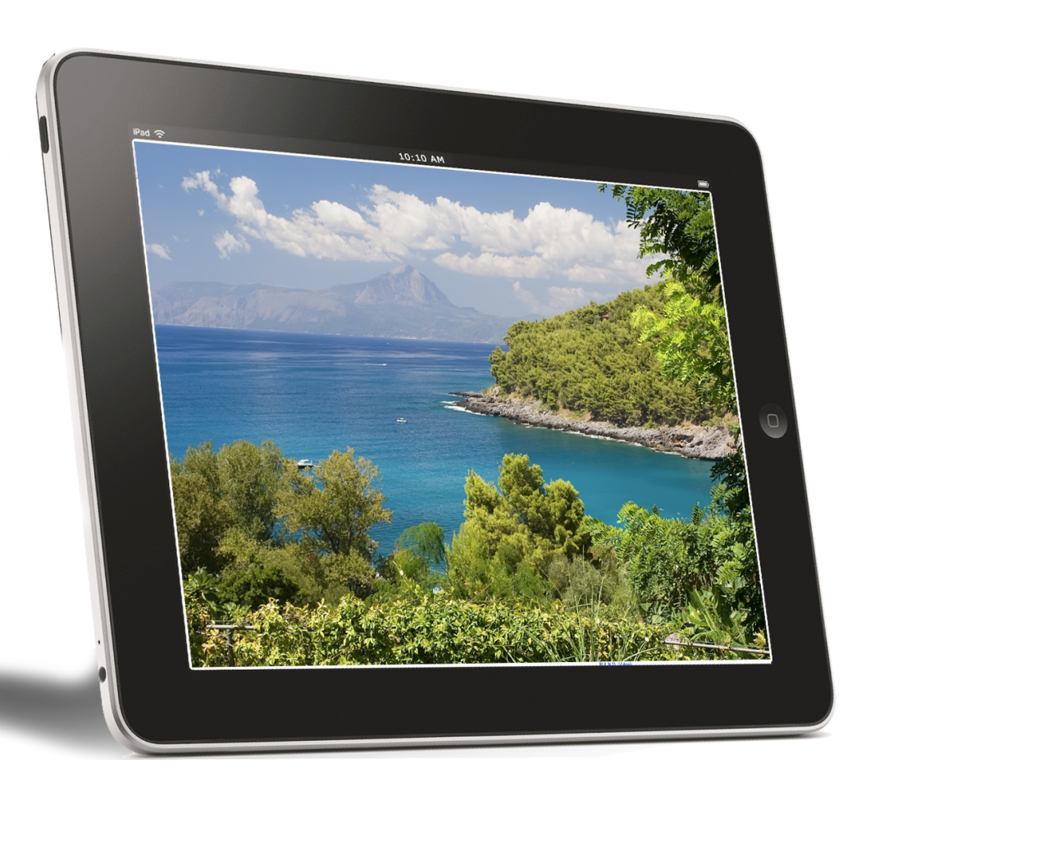



Class website
Blogs

Slide 13

Tech Across the Curriculum

Slide 14

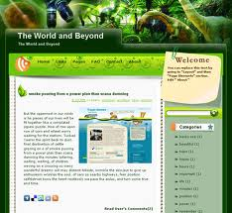
Notes:
A blog is an online log of an individual’s thoughts, ideas, creations, questions, and reflections. It is a representation of the person posting the items. In our classroom, the blog will be used as a presentation and reflection tool. Students will have access to a secure blog through our classroom website, where they will post and share their creations, like a portfolio. Students can add multimedia to their blogs, not limiting them to simply written expression.
This is also a great place to receive feedback from their peers as to their success.

Slide 15

www.mrwraysclass.weebly.com
Notes:
Students and parents will have access to the class’s website to retrieve and read about what has happened, what is happening, and what will happen. Here students can review lessons posted and review their blog posts. Parents can watch video of the activities occurring in their child’s classroom and can also view their work. There are links to other websites with excellent tools for practicing the basic skills.

Slide 16
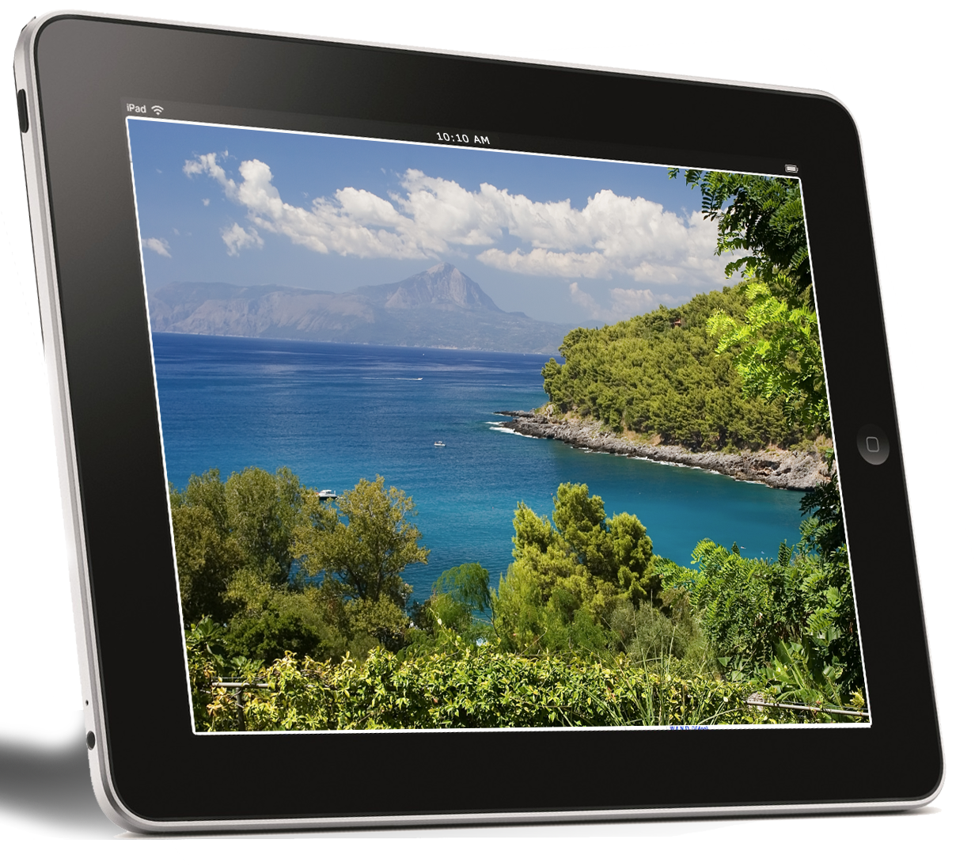
iPad
apps.
video
photos
reading
writing
research
drawing
learning.
Notes:
The iPad will be the focus piece of technology in the classroom, simply because it can be used both individually as well as collectively. With the addition of Apple TV and a smartBoard, the entire class can be connected together in a intranet of devices. Students can display their work for peers to edit, revise, or provide feedback. They can do so in front of the class or at their seat, depending on their comfort level. They can conduct research, practice academic skills, connect with people around the world through the use of an iPad.

Slide 17
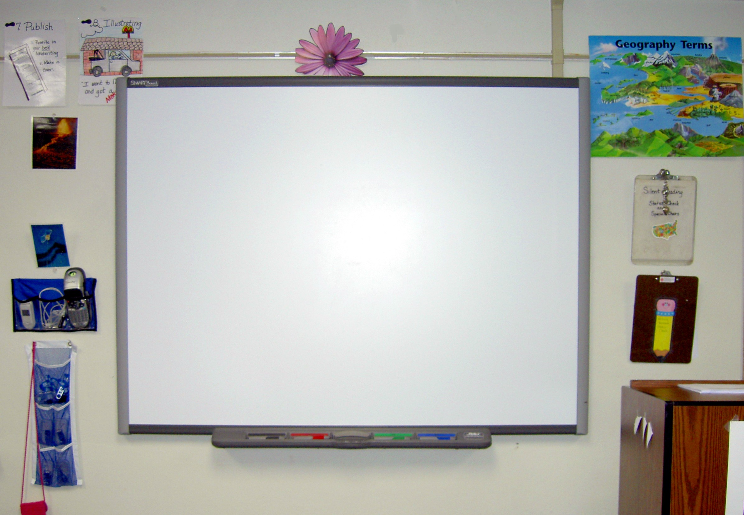
interactive
motivating
fun.
hands-on
multimodal
multimedia
cooperative
SMARTBoard
Notes:
Students will have access to the SMARTBoard in a variety of ways. They will participate in shared lessons in all curriculum areas. They will use it in small groups at centre times to practice/review current learning. Students will also be able to view displayed content, such as videos, multimedia presentations, as well as peers work.

Slide 18
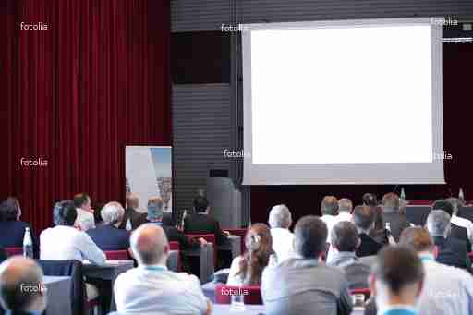
Notes:
YouTube will be used in a variety of ways. It will be used as a place to gather new information on a topic. It will also be used to view demonstrations of experiments, activities, and/or performances. The online tool will also be used to post student creations to share with others with in the community as well as around the world.

Slide 19

MATH

Slide 20


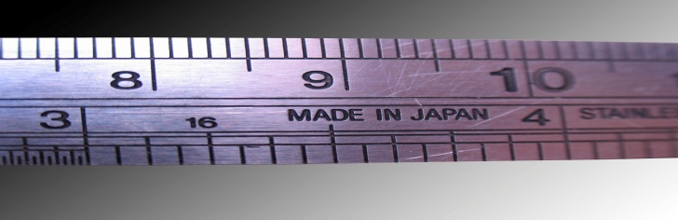
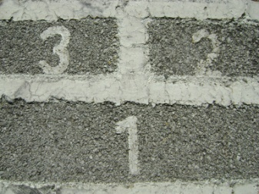

measurement
ixl.com
counting
number representation
probability
Notes:
Ixl.com is an online website that provides students from K-12 with practice in all strands of the curriculum. Students will access and practice these skills in JK during their computer lab time. Each student’s account can be accessed at home via the Internet for extra practice, too.

Slide 21

Number Skill Development
Notes:
Using this software program, students solidify their understanding of mathematical skills, such as measuring, counting, and patterning. Students complete all of these skills within a storyline, making an authentic experience.

Slide 22

R E
A
D
G
I
N

Slide 23

Online library
of
digital texts
That are
read aloud
or
Animated
Notes:
Students will use BookFLIX as a resource for independent reading during centre times & shared readings and read alouds during instructional times.

Slide 24

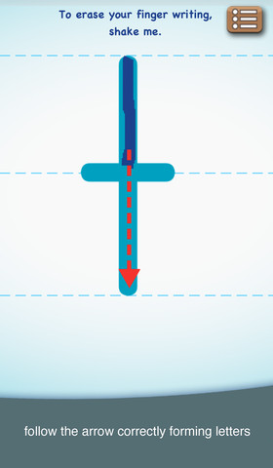
abc PHONICS
Notes:
This app. Helps students practice the sounds of the letters of the alphabet, by tracing the form of the letter and making the sound. Students will use this iPad app. to practice identifying the letters in the alphabet as well as their individual sounds. They can utilize this app. during centre time or in guided reading groups.

Slide 25

writing

Slide 26


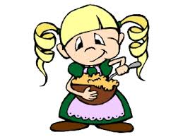


RETELL
Notes:
Students will use iPhoto, a photo editing app., as well as photos of they and their friends acting out various scenes from familiar books to create a retell. This type of writing is really engaging for students and helps them delve deeper in to the text, reflecting on the most important parts as well as their significance to the overall story.

Slide 27
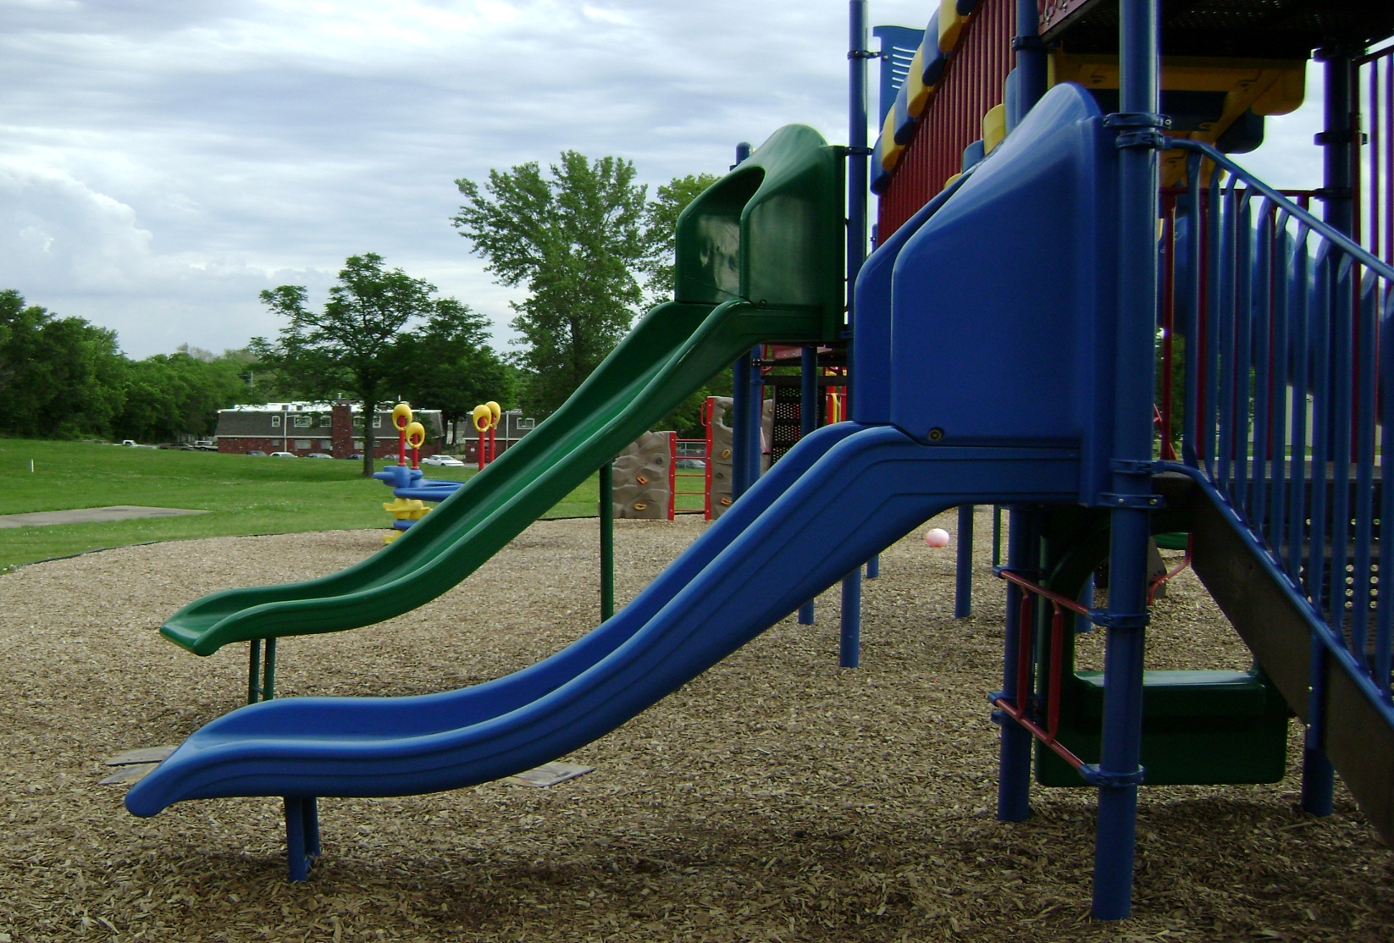
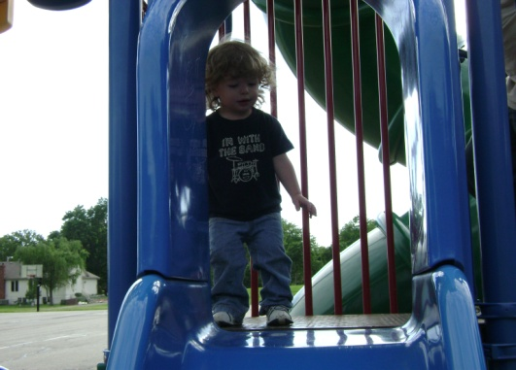
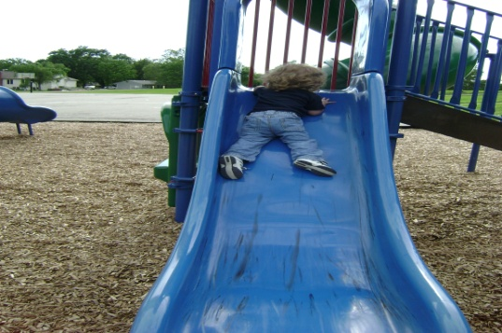
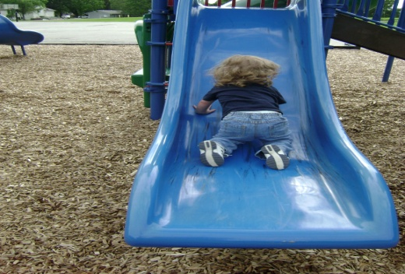
R
E
C
O
U
N
T
Notes:
Students could also use the same app. to complete a retell of a special event, time in their life, or recess activity. This process of using images helps students with their memory of the event as well as the important detail, which can often be lost in the student’s own drawing or sketching.

Slide 28



REPORT WRITING
astrod
sun
rth
Plooto
LABELLING
Notes:
Students can use photos found on the Internet to create a diagram with labels of the information they have learned for a report on a topic of their choice. Students could even take photos themselves of the features of their topic and add labels, using the iPhoto app.

Slide 29
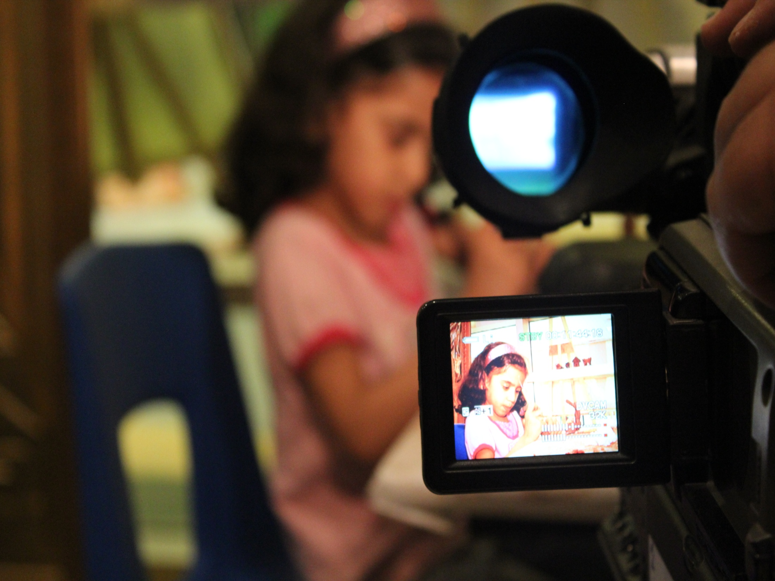
Notes:
Students can complete the same activities as mentioned above using iVideo, a video editing app., which allows users to create unique footage.

Slide 30
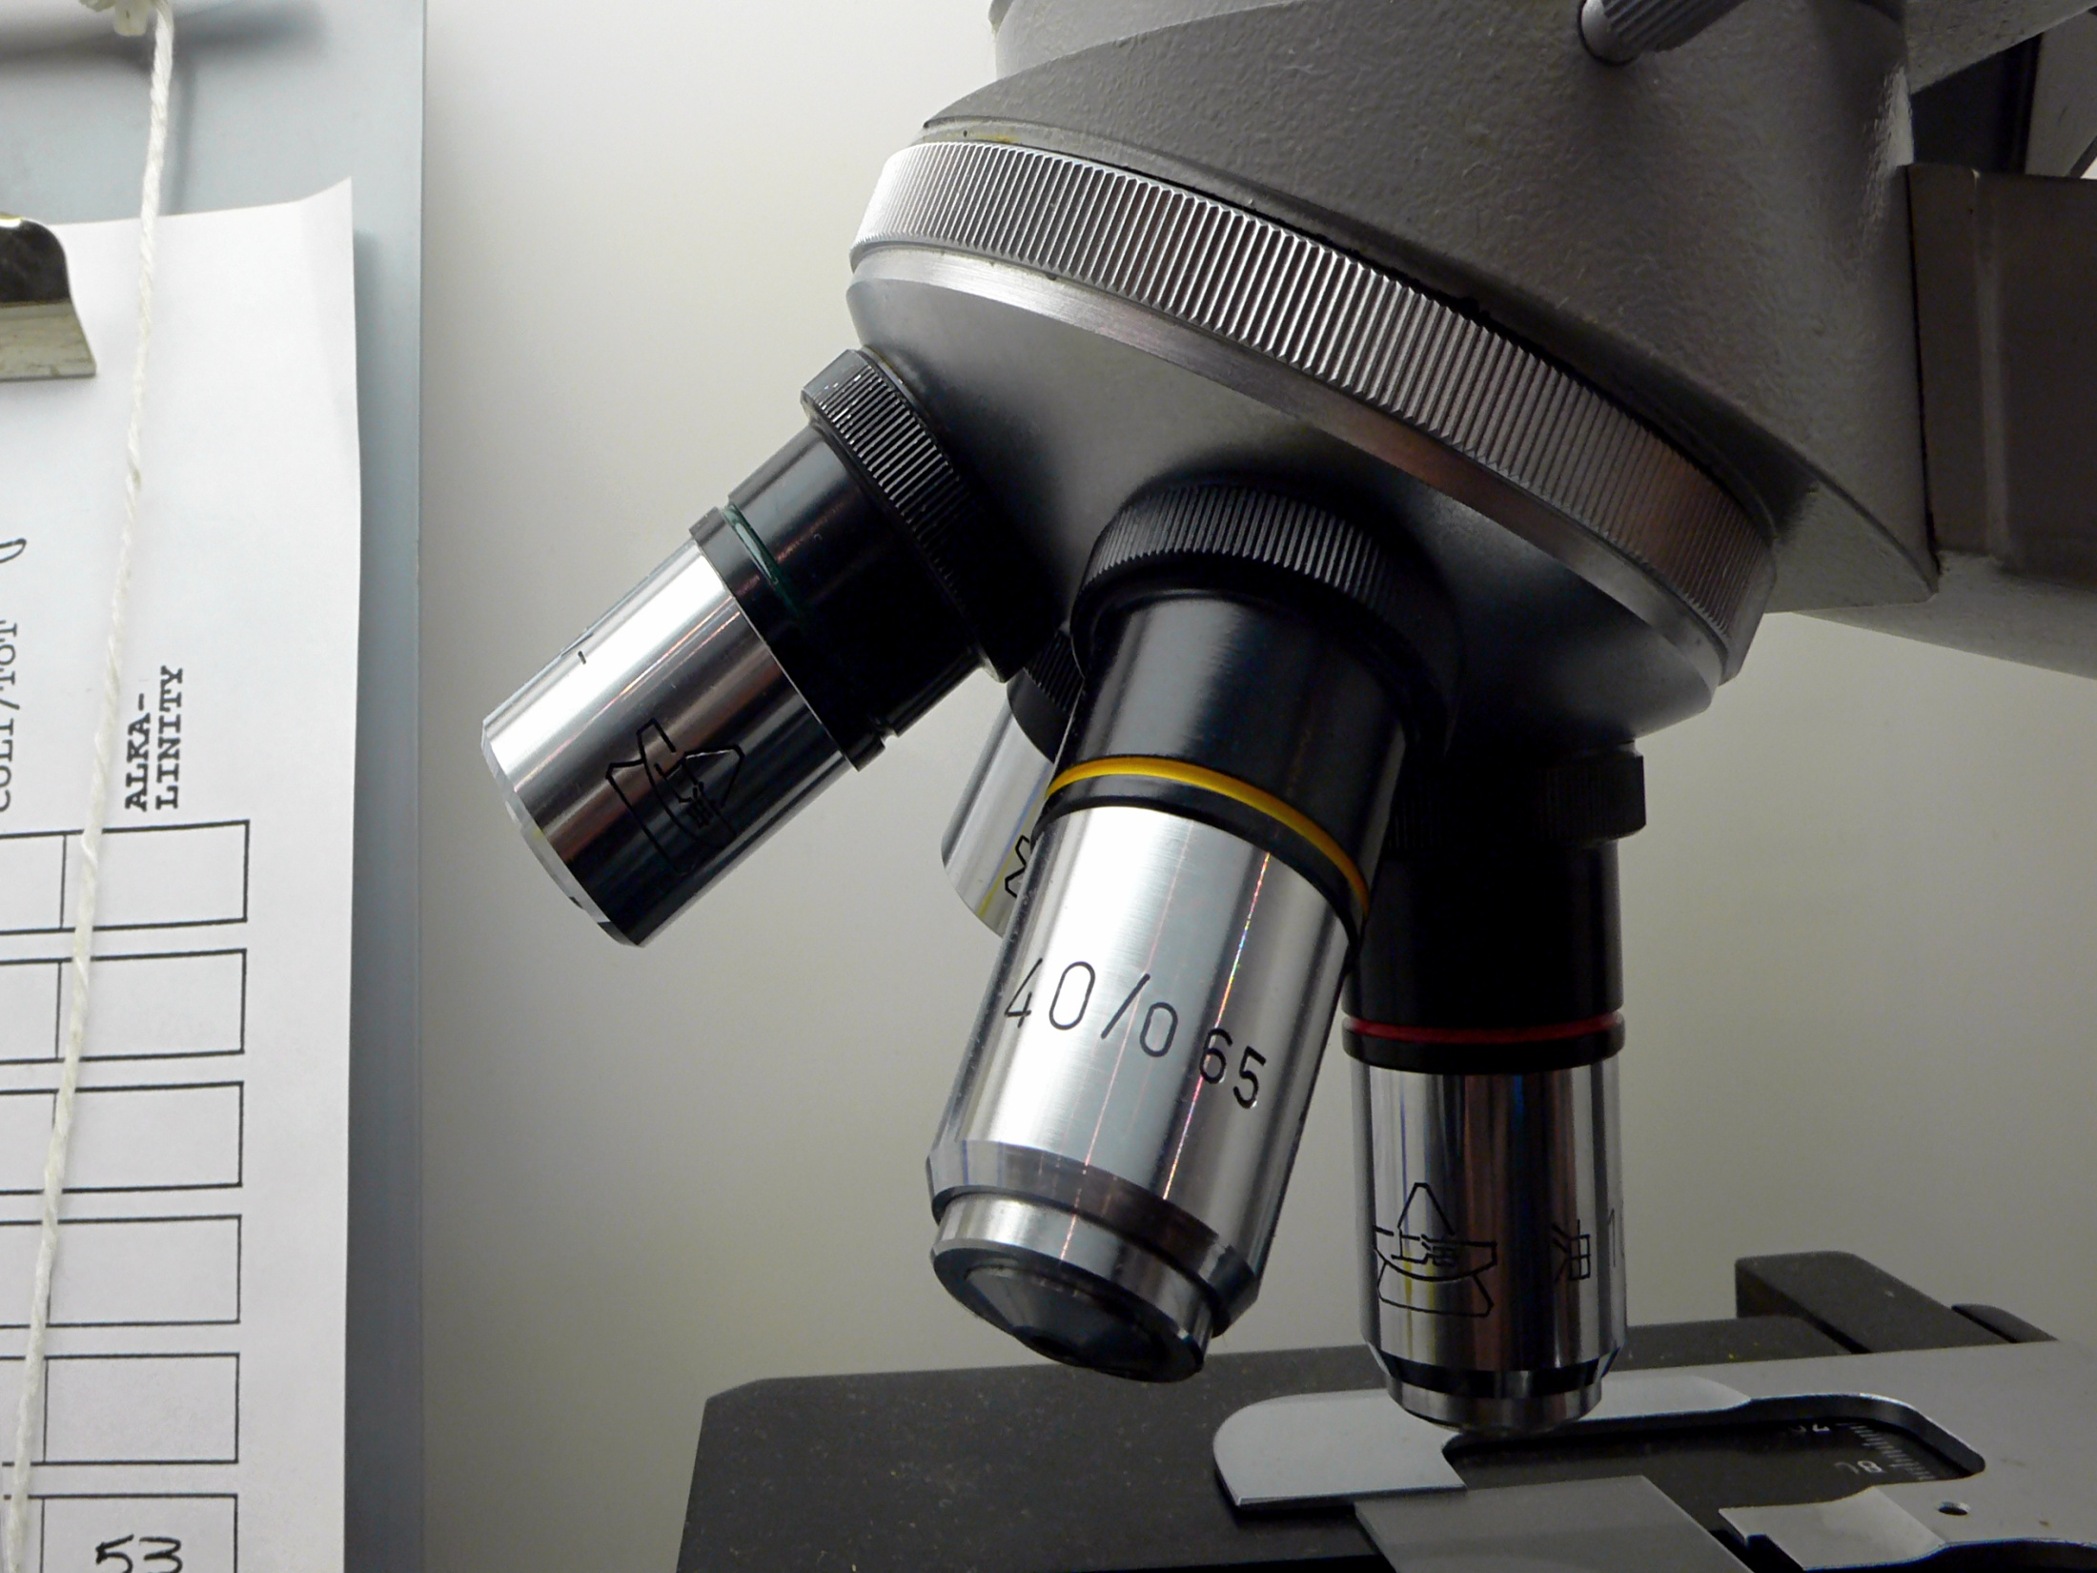
Science

Slide 31
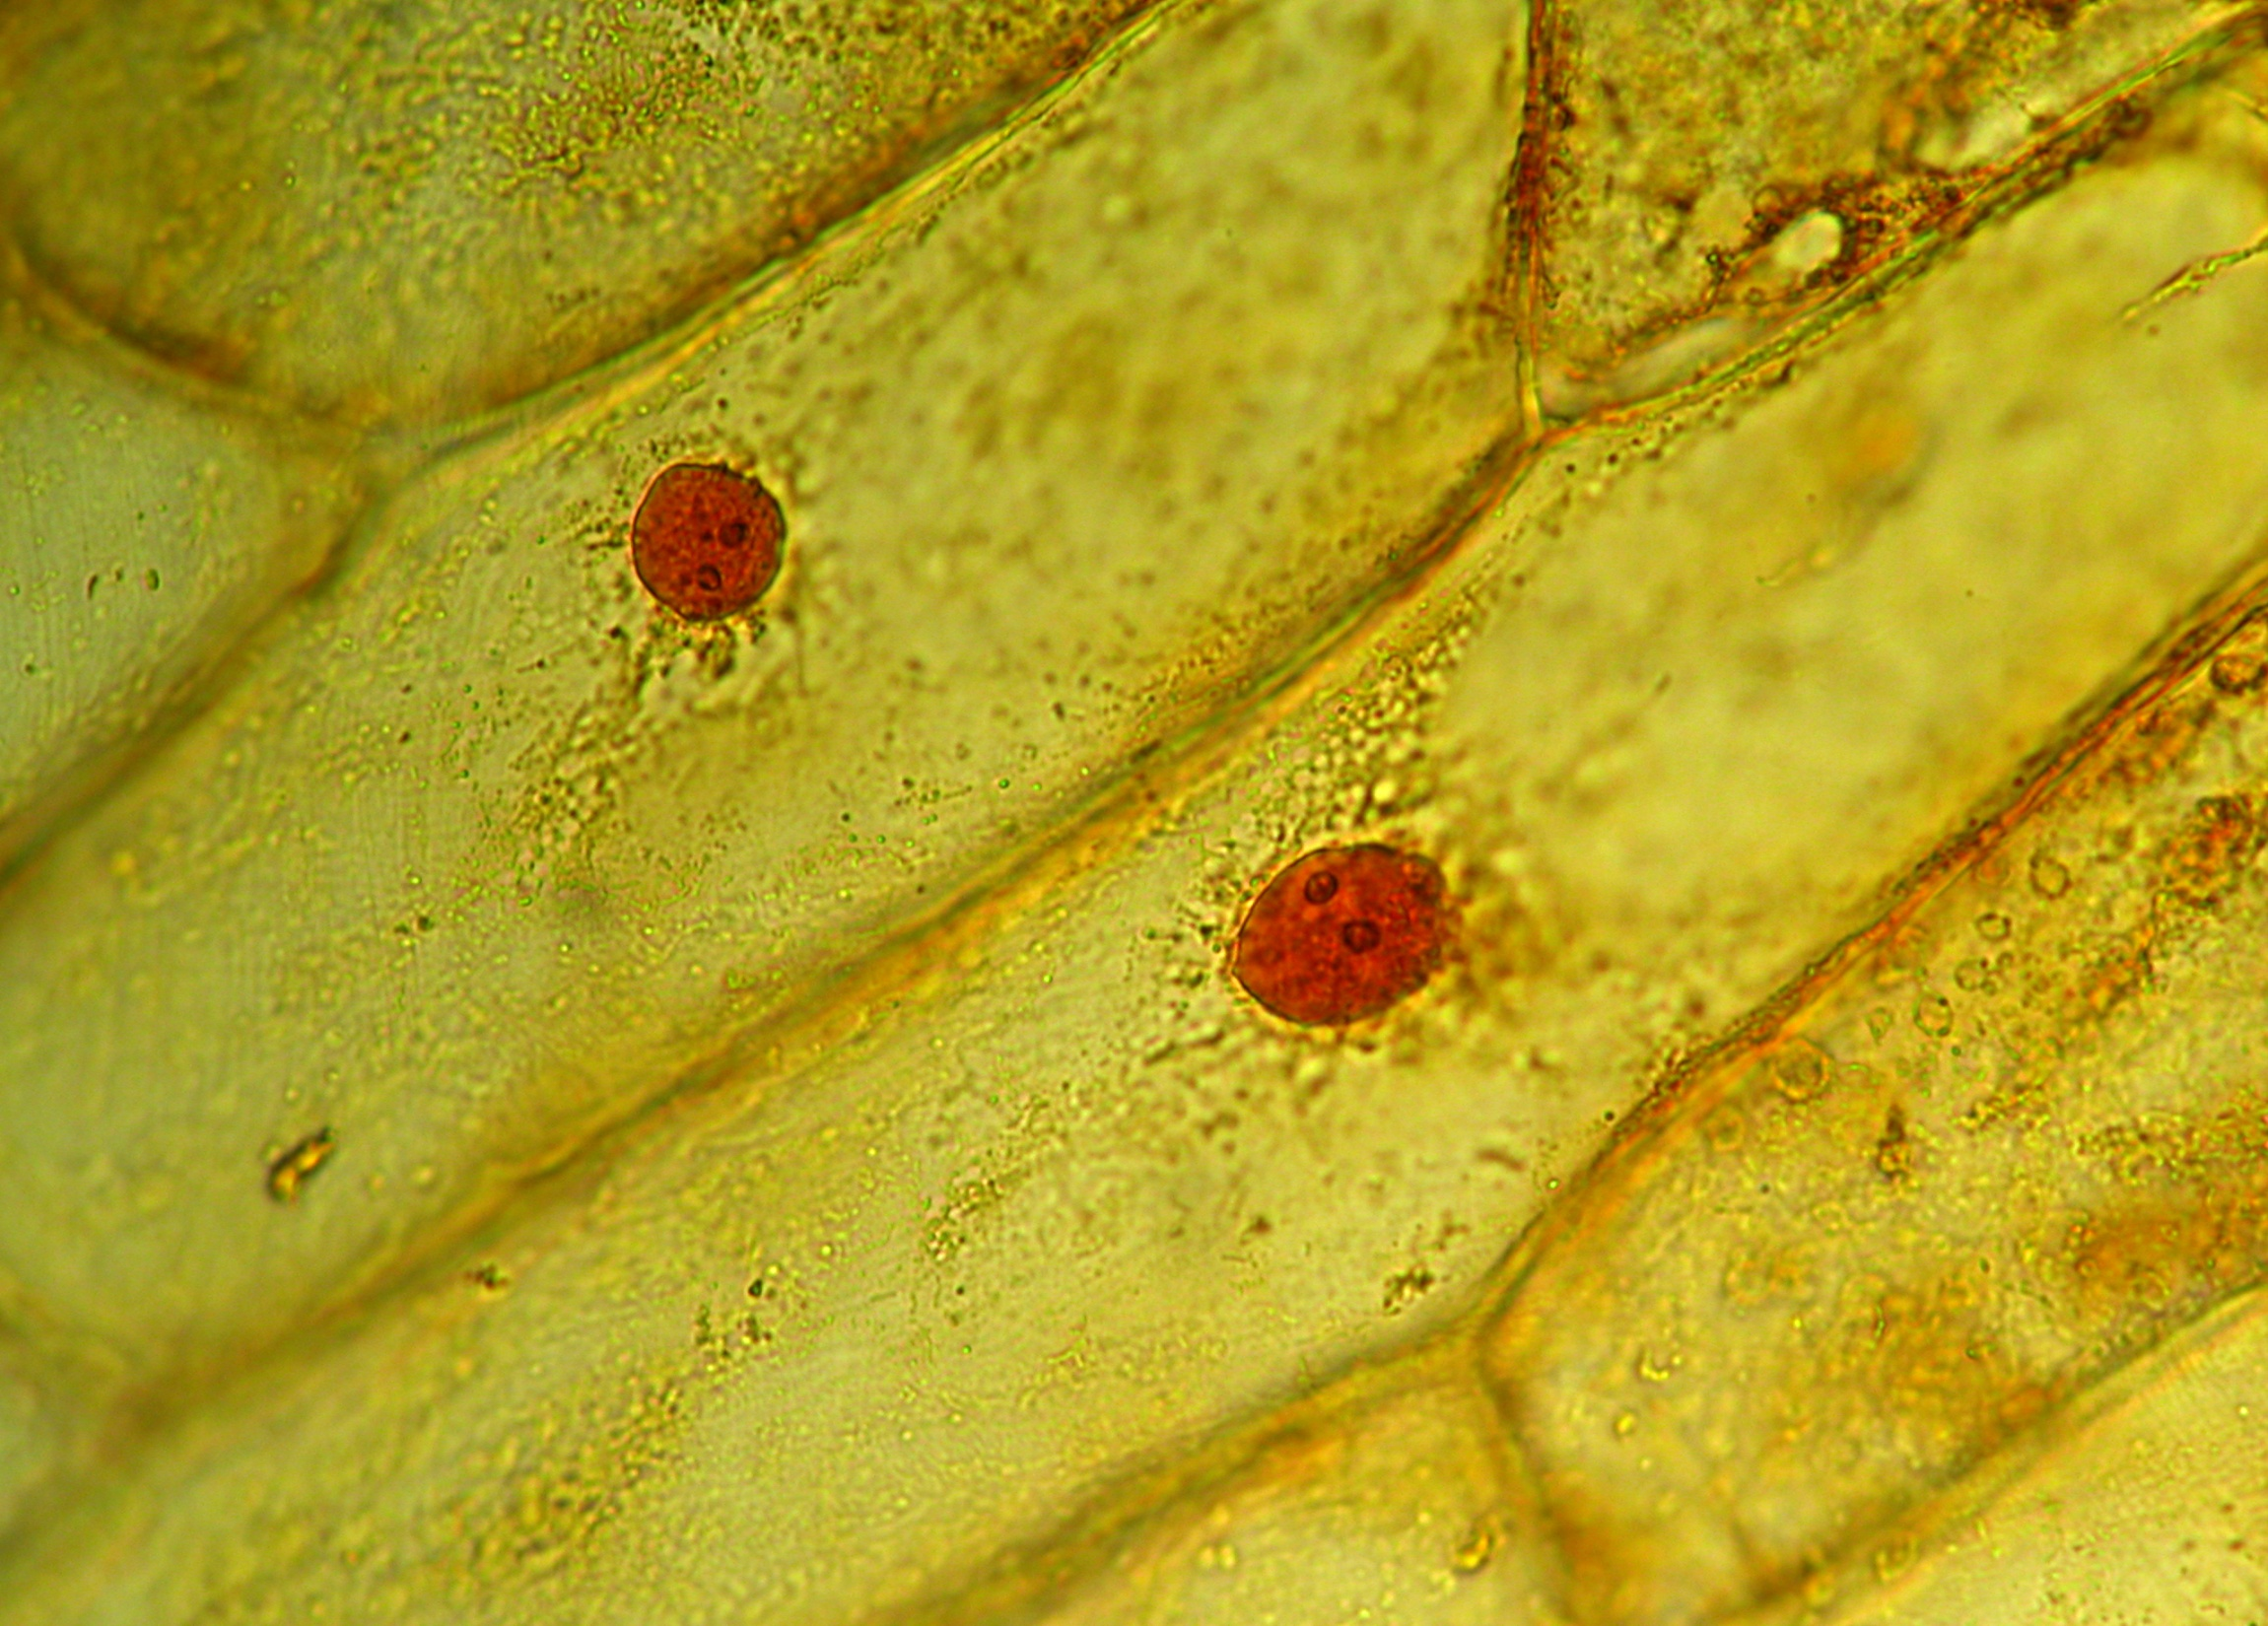
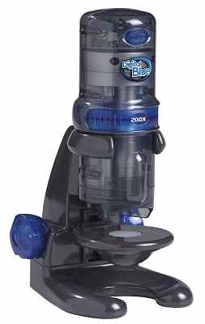
Digital blue microscope
Notes:
Coupled with the smartBoard, the digital blue microscope can bring the tiny and miniscule to life for students to see the inner workings of the animals and insects of our world. Students will use their prior knowledge and ideas to predict what they think they will see under the microscope for a variety of objects. They can then use their sketching skills to sketch the results of their investigation and add labels for the detail.

Slide 32
Notes:
Students can access and view YouTube videos on scientific topics to gather new information or to verify their findings from a variety of experiments. They could also use the iVideo app. to create a video of an experiment they have conducted and share it on the web for others to view and comment.

Slide 33

Notes:
The teacher will make use of some of the technology as a means to record student success. He will record the student(s) demonstrating their learning, in order to access it at a later date, say in a parent-teacher interview.
Students will use the appropriate technology to revise and edit their work. The recordings of student work that the teacher collects will be shared with the student in a student-teacher conference, where together student and teacher will review the success criteria and the student’s success in meeting them.

Slide 34

EXAMPLE ASSESSMENT TASK
Students will demonstrate their understanding of a retell by performing a rendition of a familiar story read to them by the teacher. Students will use the iPad as well as the iPhoto/iVideo app. to create their retell. Students may use self-created puppets, classroom puppets, narration, live performance, or pictoral scenes with captions to retell their story.

